Slide 1


Smart Traffic Density Control System
IOT Lab Project
Sai Charan Gokha (123CS0168)
Anmol Jain (123CS0170)
Samkit Jain (123CS0171)
Group 19 :

Slide 2


Our Solution: A Dynamic & Smart System
Our Goal
The Outcome
To design a smart system that measures real-time vehicle density in multiple lanes. This provides an accurate, live picture of the traffic load, rather than just guessing with fixed timers.
This live data is sent to a server via CoAP and visualized. It can then be used to dynamically adjust traffic light timings or recommend rerouting, drastically improving efficiency.

Slide 3





System Architecture
1. Sensing
2. Processing
3. Reporting
Eight ultrasonic sensors (two per lane) are used to detect vehicles entering and exiting a defined road segment.
An ESP32 microcontroller processes sensor data to calculate the true vehicle count (density) for each of the four lanes.
The density data is sent via Wi-Fi using the lightweight CoAP protocol and visualized on a live web dashboard.

Slide 4
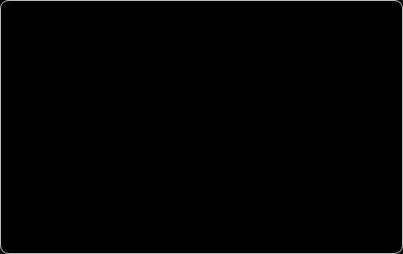
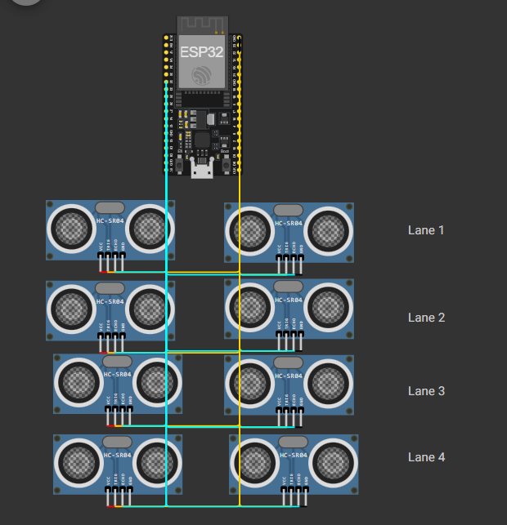
Technology Stack: Hardware
ESP32-DevKitC v4
The "brain" of the project. Chosen for its powerful processor, built-in Wi-Fi, and ample GPIO pins to handle all 8 sensors.
HC-SR04 Ultrasonic Sensors (x8)
Used for distance measurement. They are low-cost, reliable, and provide the raw data for our density calculation.

Slide 5
Technology Stack: Software
Arduino C++ (ESP32 Core)
Used to program the microcontroller, read sensor data, and perform the density-counting logic.
CoAP (coap-simple.h)
A lightweight, low-power IoT protocol (runs on UDP) perfect for sending data from constrained devices like the ESP32.
HTML, CSS, JavaScript
Built the real-time monitoring dashboard to visualize the data being sent from the ESP32.

Slide 6


Core Logic: True Density Counting
The "In/Out" Method
State Change Logic
A single sensor only shows occupancy. We use two sensors per lane (Entrance and Exit) to track the actual vehicle count.
Entrance Sensor (Free → Occupied):
`Vehicle_Count++`
Exit Sensor (Occupied → Free):
`Vehicle_Count--`

Slide 7
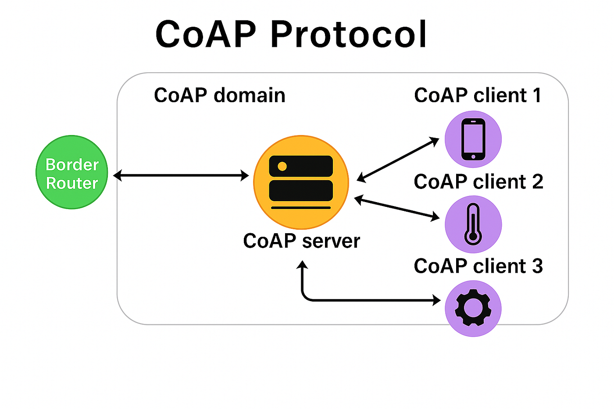

Why CoAP? (IOT Lab Focus)
»
CoAP stands for Constrained Application Protocol.
»
It is designed specifically for **IoT devices** (like our ESP32) that have limited processing power.
»
It runs on UDP, not TCP, making it much faster, lighter, and more efficient than HTTP for sending small, frequent data packets.
»
This makes it a perfect choice for an "IoT Lab" project.

Slide 8
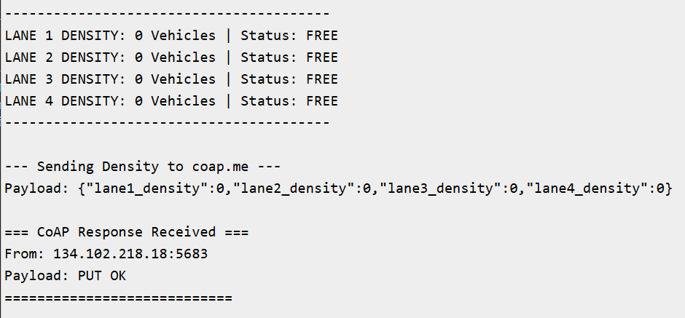
The Data Payload (JSON)
{ "lane1_density": 2, "lane2_density": 6, "lane3_density": 1, "lane4_density": 0 }
The ESP32 formats the density counts into this simple JSON string and sends it via CoAP every second.

Slide 9
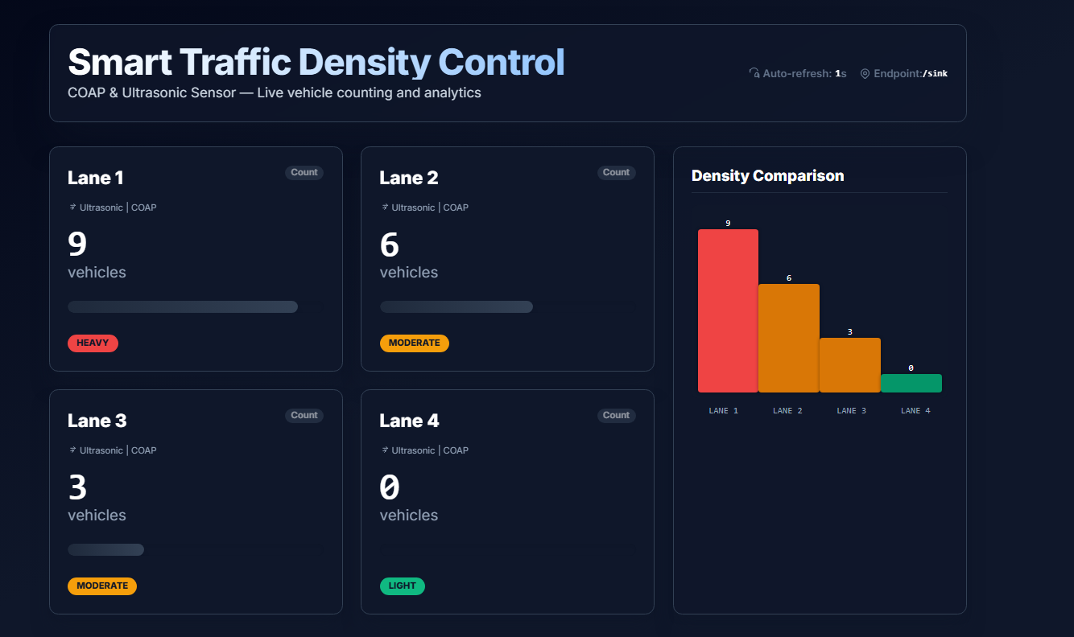
The Live Dashboard
Real-Time Visualization

Slide 10
Thank You
github.com/anmol0705/SmartTraffic-Density-Monitoring-System-COAP

